Slide 1



Personal presentation
-
Duvivier Valentin
2020-05-18
Photo: Lucas Westin
1

Slide 2

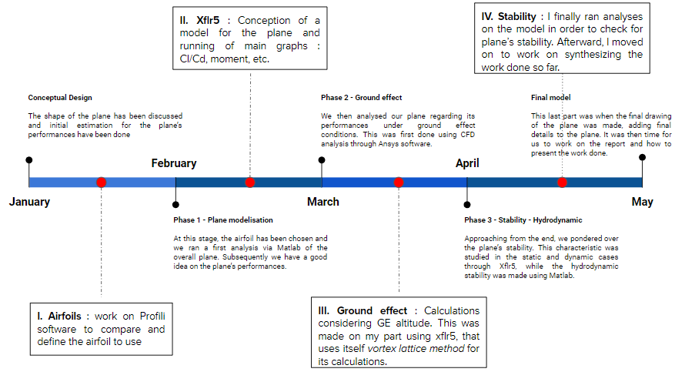
Aerodynamics/Aircraft Performance
Timeline
2

Slide 3
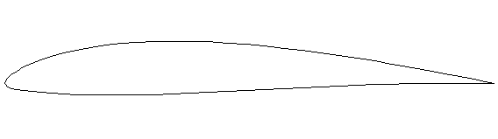
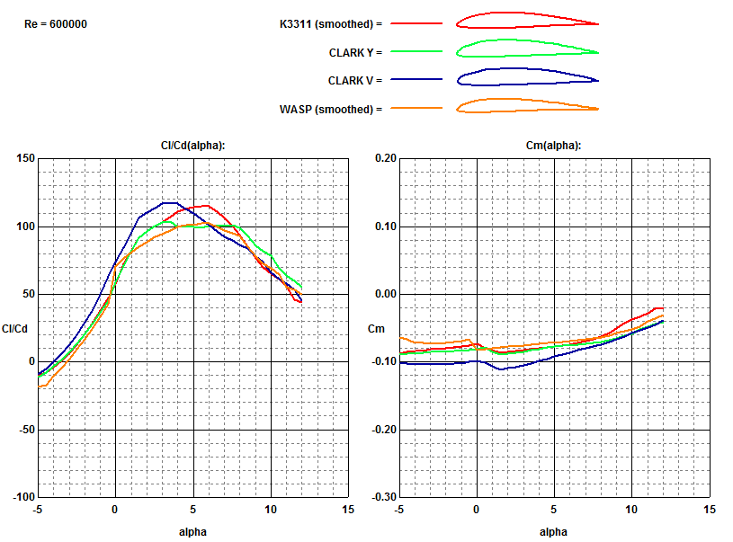
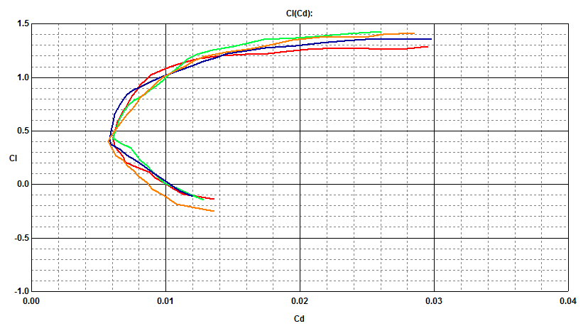
I.a - Airfoil Selection
K3311
K3311 | AOA | Cl / Cd | Cm
Ranges | 3 to 7° | 100 to 120 | -0.08 to -0.06
3

Slide 4
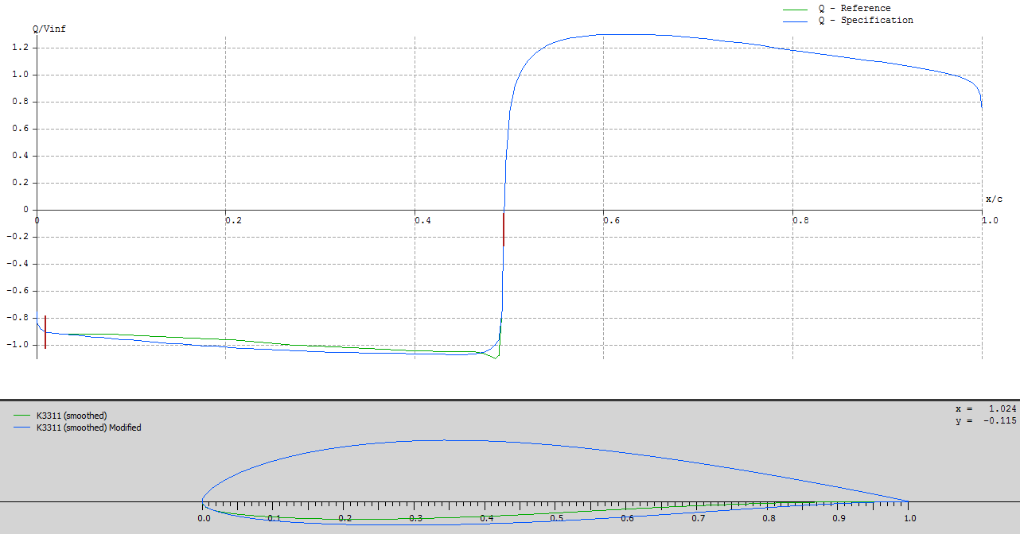
I.b - Airfoil Optimisation
4

Slide 5
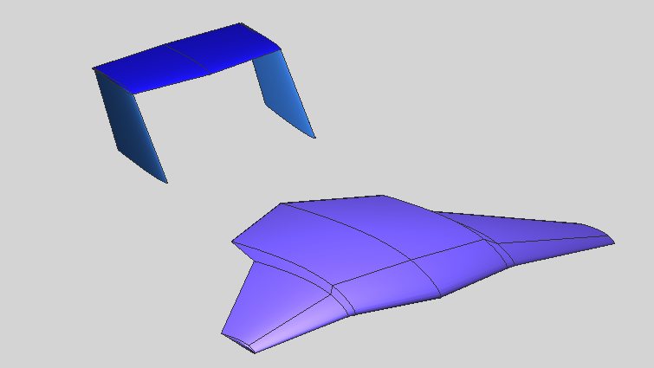
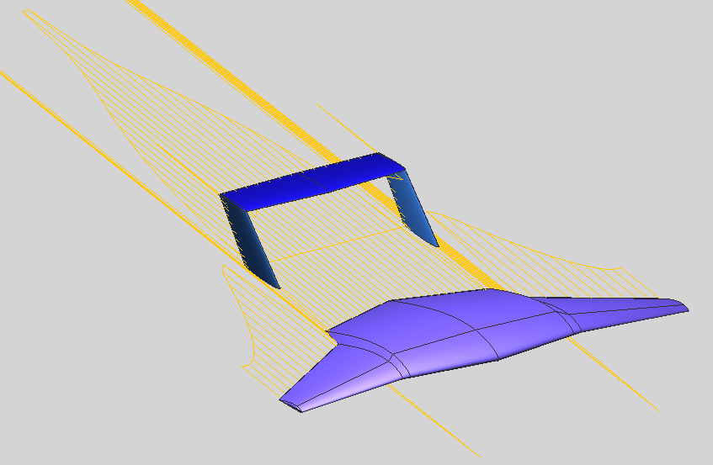
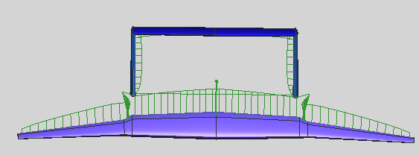
II - 3D model
Fig 1 : Plane’s model
Fig 2 : Drag force
Discontinuities at cross sections
AOA = 5°
v = 16.30 m/s
h = 0.5 m
Fig 3 : Lift force
5

Slide 6
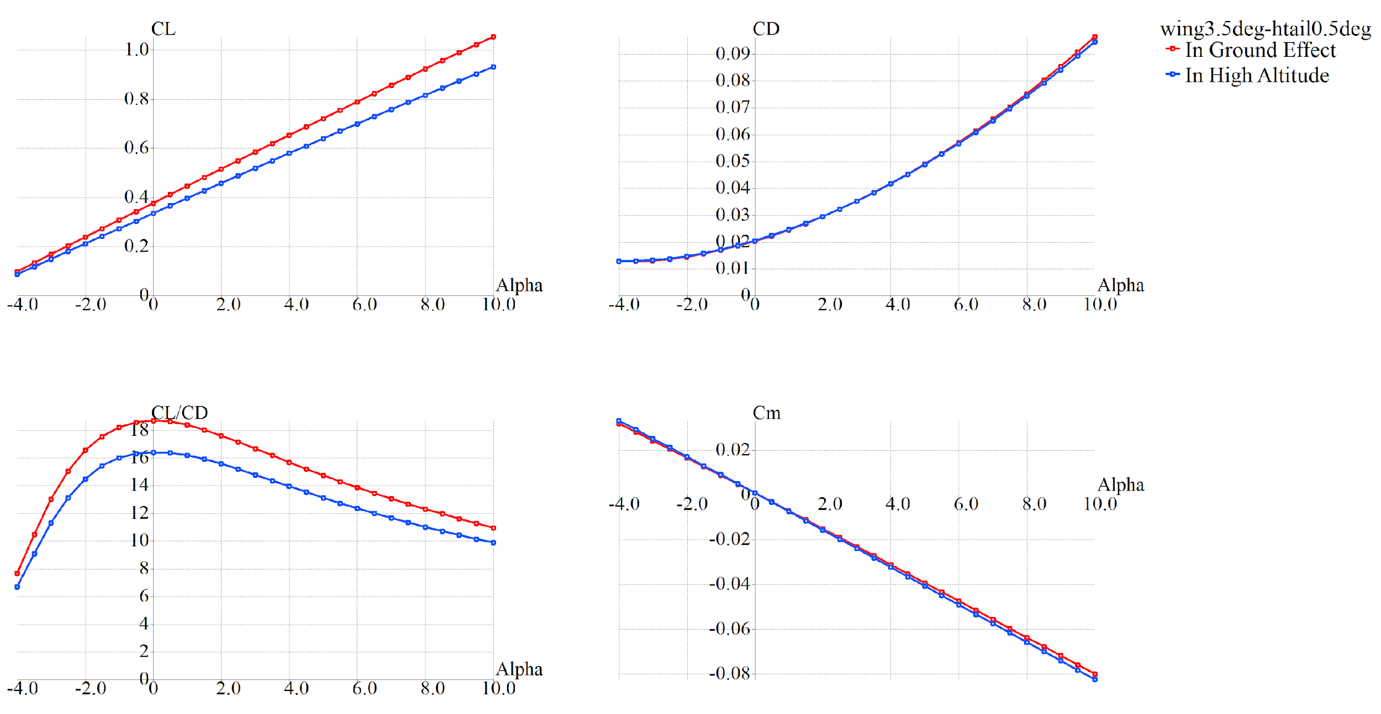
III - Ground effect
6

Slide 7
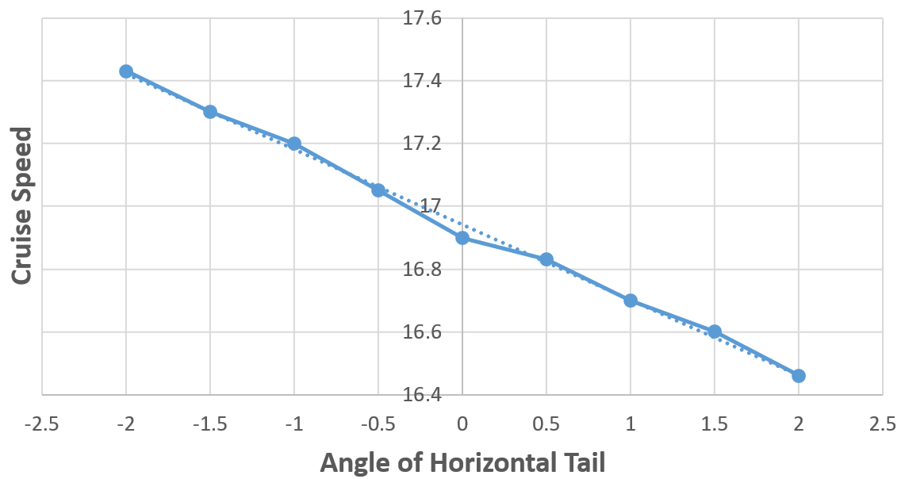
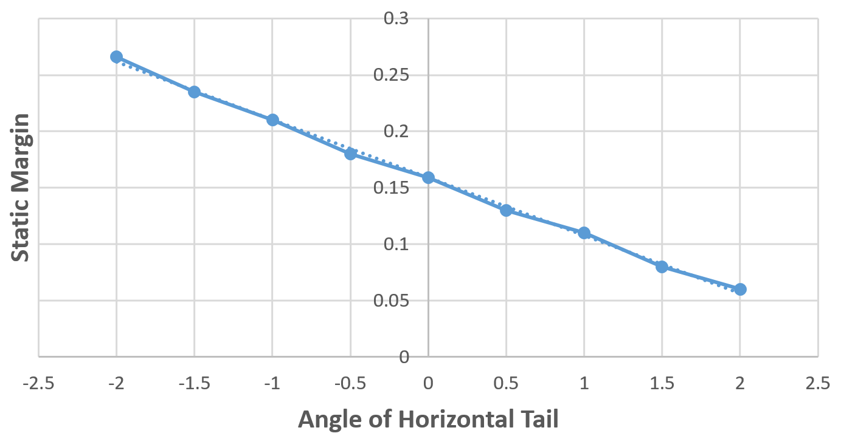
IV - Stability
Target Point
7

Slide 8
Balance sheet
Skill radar
Main tasks achieved
Consistent way of defining adapted airfoil
Natural optimization of stability
Detailed stability
Principle of Ground effect
8

